Slide 1
Welcome Senior Parents!
CLASS OF 2018

Slide 2
GOALS FOR TONIGHT
Obtain updated senior contact information
Review CMS graduation requirements
Discuss College Options
Explore the college admission process (Private & Out of State Colleges/ Universities)
Discuss application process
Explain Senior transcript and letter of recommendation procedures

Slide 3
GRADUATION REQUIREMENTS – 24 CREDITS
Courses | Credits
English | 4 credits
Math | 4 credits
Science | 3 credits
Social Studies | 4 credits
Health/PE | 1 credit
Foreign Lang./CTE/Art | 2 credits
Additional Electives | 6 credits
CPR Certification * | Pass
* CPR certification is completed in NC public middle school 8th grade health class. All others will be notified about process to complete certification.

Slide 4
It is important to have strong ACADEMIC courses senior year!
• Colleges are very sensitive to senior year course selection and grades
• Colleges can withdraw an acceptance based on the final transcript submitted
• If your student is entering the military after high school, their options can be limited by poor performance senior year

Slide 5
SCHEDULE CHANGES
Colleges make admission decisions based on the courses that are submitted to them, so...
It is your student’s responsibility to contact the colleges they have applied to if they have changed their schedule
Schedule changes can affect admission decisions, scholarships, honors programs, etc.
Colleges expect that you will pass your current classes

Slide 6
FINDING A MATCH
Know yourself...Identify the priorities for you and your family
Create a list of 3-5 schools (safety, likely, reach)
Look for schools that match your student’s strengths and learning style
Location, Size and Type of School – VISIT COLLEGES CAMPUSES
Be realistic and maintain perspective
Remember, 84% of all colleges accept more than 50% of the students who apply to them, according to the National Association for College Admission Counseling
Notes:
SAFETY -Student far exceeds college admissions average GPA and test scores.
LIKELY -Student has the average college admission GPA and test scores.
REACH -Student is below the college admission average GPA and test scores.

Slide 7
COLLEGE OPTIONS

Slide 8
Community College
2-year college, students can receive an Associate degree, pursue an applied career path, or choose to transfer to a 4-year University(for 2 years)

Slide 9
6 Reasons to Consider Community College
1. You are short on college funds
2. You are not sure about college
3. You are not sure what kind of program you want to pursue
4. Your GPA is not so great and you want to build your skills before transferring
5. You’d like a career-oriented degree, such as a fashion- design or computer-certification program
6. You work, or have commitments, and need a flexible schedule. Many Community Colleges have articulation agreements with four year colleges and universities allowing students to transfer as a junior. Check with colleges for program details
Source: College Board

Slide 10
UNC STATE SYSTEM: Minimum Admission Requirements
Year | Minimum GPA | Minimum SAT (reading & math) | Minimum ACT Composite
Fall 2013 and beyond | 2.5 | 800 | 17

Slide 11
Out-of-State Colleges
Admission requirements vary by institution
Often use “committee” type admission process
Students should check with individual campuses/websites to determine admission requirements & deadlines
Many campuses use the Common Application

Slide 12
FACTORS IN COLLEGE ADMISSION
Grades in all courses
Standardized admissions tests (SAT, ACT)
Class rank
Essay or Personal Statement
Letters of Recommendation *
Student’s Demonstrated Interest *
Interview *
Work/Extracurricular Activities *
*** These factors become more important when student GPA and Test Score are average/below average range***
Notes:
Source: NACAC
GPA
Rigor
Test Scores
Additional factors:
racurricular activities
Leadership roles
College application essays
Letters of recommendations
Resumes, interviews, portfolios
Demonstrated interest

Slide 13
Definitions of Admission Options
Regular Decision: submit application by institution’s specified date and receives a decision within a stated period of time.
Rolling Admission: institution reviews applications as they are completed and renders admissions decisions to students throughout the admissions cycle.
Early Action (EA): students apply early to an institution of preference and receive a decision in advance of the regular response date. Students admitted under EA are not obligated to accept the offer of admission.
Early Decision (ED): students make a commitment to a first-choice institution, where, if admitted, they definitely will enroll. When applying ED, student may apply to other institutions, but may only have one ED application pending. Students should check with individual schools regarding specific policies in the Early Decision agreement.

Slide 14
COLLEGE APPLICATION PROCESS
October/November: Early Decision/Action Deadlines
December/January: Most application deadlines
Be aware of deadlines. Colleges will rarely make exceptions for late applications.
October 1st New FAFSA opening date
March: FAFSA must be completed by March 1
April: Financial aid packages are sent out
May 1: National Notification Deadline

Slide 15
In an admissions report from Massachusetts Institute of Technology’s Education Council the following reminder was given to future applicants:
“People do not apply to colleges: folders do. The folder and application are the single opportunity to influence the process. Approach each aspect of the application as an opportunity. Devote time and thought to each of the various portions.”

Slide 16
STEP 1 — The Application
Students complete the application online
Applications and instructions on the application process/requirements can be found on the colleges’ websites.
Review what you will need for the application to be complete: Essay? Letters of Recommendation?
Students are responsible for confirming with their assigned counselor that any necessary documents have been received. Do NOT assume they have it/know about it.
Fill out the application completely!

Slide 17
THE COMMON APP
www.commonapp.org
Provides an admission application to around 450 different colleges
Has a number of different sections—student should see his/her counselor for assistance!
If more than one college that your student is applying to is on the common app, it is easiest to use the common app rather than the individual school application

Slide 18
THE COMMON HBCU APP
http://commonblackcollegeapp.com/
Allows students to apply to 43 HBCUs for a $35 fee
Must complete all sections

Slide 19
CFNC.org
Can use this website to apply to colleges in North Carolina
Can use this website to send transcripts FOR FREE!
November 13th – 17th = College Application Week
Check CFNC.org to see which schools are waiving application fees

Slide 20
STEP 2 - The Admission Essay
If your student’s application requires an essay, they should follow the directions and make sure to answer the question(s)
Students should proofread their writing
Students should be authentic! Don’t write about what you think they want to hear
Colleges are really stressing the importance of the essay in the application review process!
“Students always ask me, ‘What would you like to see in an essay?’ And my answer is that it’s not what I want to see. It’s what you want to tell us.”
Amy Abrams, Dean of Admission, Sarah Lawrence College

Slide 21
STEP 3 - Letters of Recommendation
Not every college requires letters of recommendation!
Schools are most interested in seeing letters from teachers of core subjects.
Letters of recommendation are CONFIDENTIAL. Students should provide teacher/counselor with addressed envelope to mail letter upon completion.

Slide 22
COUNSELOR RECOMMENDATION
Some colleges require a counselor recommendation
Provide your counselor with a copy of your college application resume. Your resume must include extracurricular activities, work experience, academic achievements, and volunteer/community service experience.
Allow plenty of time... Good letters require considerable time and effort and you don’t want to rush a person who is trying to help you. You must give your recommenders at least 2 weeks to complete a letter of recommendation.

Slide 23
STEP 4--Submitting an Application
Review carefully to make sure your student has completed all sections of the application and to check for errors.
Student will then request a transcript

Slide 24
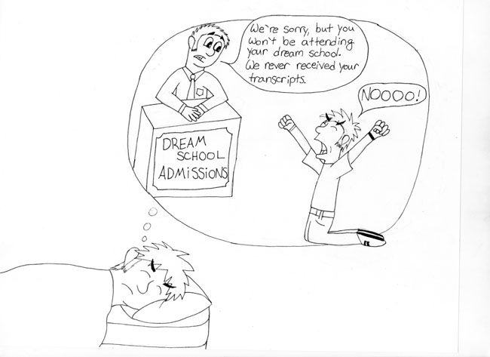
HOW TO REQUEST A TRANSCRIPT

Slide 25
IN-STATE SCHOOLS: WWW.CFNC.ORG OUT-OF-STATE SCHOOLS: HTTPS://CMSNC.SCRIBORDER.COM/ Paper Copy: STUDENT SERVICES

Slide 26
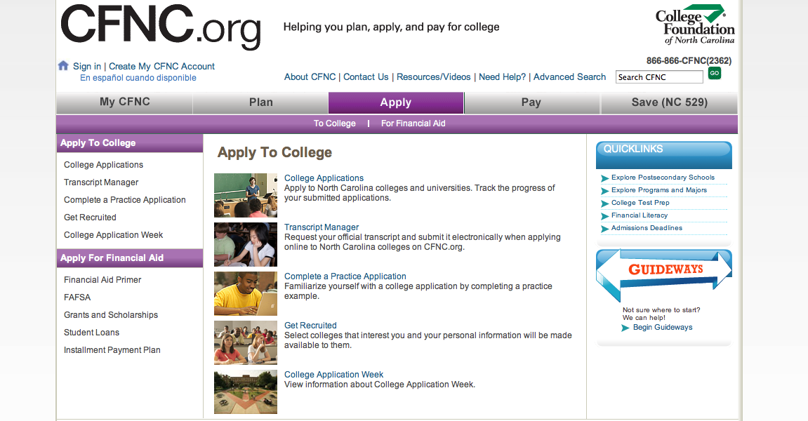

Slide 27
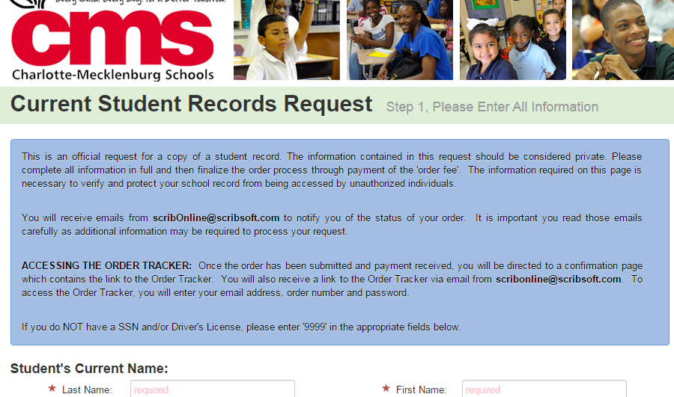

Slide 28
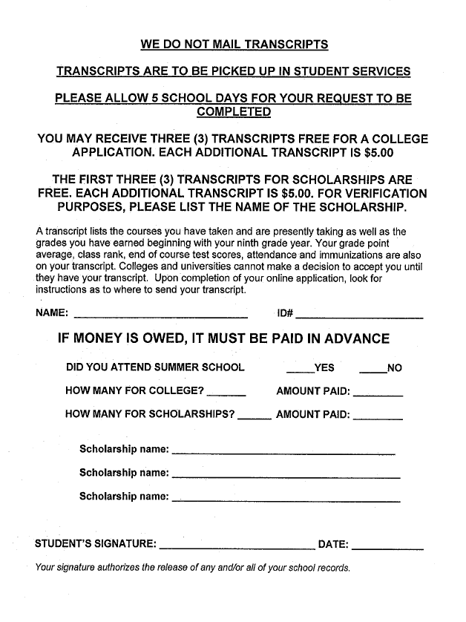

Slide 29
NCAA ELIGIBILITY CENTER
In order to be eligible for Division I & II athletics, students must register with the NCAA Clearinghouse.
Registration is done online at:
www.eligibilitycenter.org
You are responsible to manage your NCAA Eligibility
Once you have completed the form you must inform Mr. Gettings in order to upload your transcript to the site. 2 transcripts will be uploaded. 1 at the time of registration and 1 at the end of the school year.

Slide 30
SCHOLARSHIPS & COLLEGE VISITS
Listen to announcements and watch the roll/scroll for most recent scholarships and college visits.
A live link to the scholarship spreadsheet is linked through the Student Services weebly and the weekly Titan Life newsletter.
The most important source for financial aid for most students is the FINANCIAL AID OFFICE at the school they will attend.

Slide 31
Financial Aid
www.fafsa.ed.gov
Opens October 1st
You will need (for you and your parents):
Your social security number
Your Alien Registration Number (if you are not a US citizen)
Your most recent federal income tax returns, W-2s, and other records of money earned
Bank statements and records of investments (if applicable)
Records of untaxed income (if applicable)
An FSA ID to sign electronically

Slide 32
IMPORTANT DATES
SENIOR ON-TRACK MEETINGS: Starting September 25th
CACRAO COLLEGE FAIR – October 5 @ Charlotte Convention Center (must turn in permission slip)
ACT – October 28th and December 9th
SAT – October 7th , November 4th and December 2nd
Senior Parent night TBA
November 2nd, 7th, 14th (NC State, UNCG, WSSU, NCCSU, UNC Chapel Hill. High Point, NC A&T)

Slide 33
Top 5 reasons to celebrate sending your son/daughter to college...
5. More sleep. Less worrying (maybe).
4. Build up frequent flyer miles.
3. Washing clothes won’t be so agitating.
2. Pulling out your wallet once a quarter is better than once a day.
1. You are that much closer to retirement.

Slide 34
For more information…
CONTACT YOUR STUDENT’S COUNSELOR
Ms. Quintana: A-E
jenniferl.quintana@cms.k12.nc.us
Mr. Gettings: F-K
Byron1.gettings@cms.k12.nc.us
Mrs. Conner: L-Re
anne.conner@cms.k12.nc.us
Mrs. Teague: Ri-Z
kellyd.teague@cms.k12.nc.us

